Slide 1


MapReduce on Hadoop
-
Spark
Professor: Prem Nair
Group:
Tai Ho
Natnael Weldemichael

Slide 2
Agenda
1. Hadoop on Hortonworks
2. Eclipse setup Using Maven Project and POM
3. Pair Approach
4. Stripe Approach
5. Hybrid Approach
6. Spark

Slide 3
Hadoop on Hortonworks
First we need to download the following applications and jar files.
1- Download VirtualBox from Oracle (https://www.virtualbox.org/wiki/Downloads)
2- Download Appliances(Sandbox) for the VirtualBox from Horton Works (http://hortonworks.com/hdp/downloads/)
Download the one that says for VirtualBox. 3- Download Hadoop Version 2.6.0 from Apache using this link (http://mirror.symnds.com/software/Apache/hadoop/common/hadoop-2.6.0/) The version needs to be the same with the one available inside horton.

Slide 4
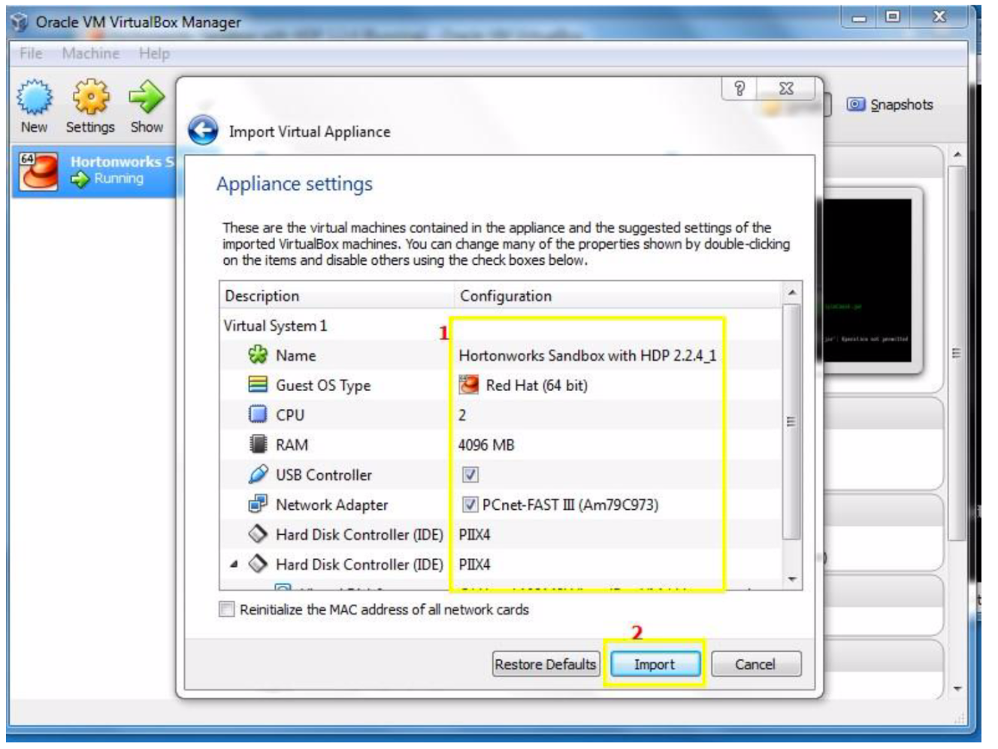
https://github.com/taihuuho/Big-Data/blob/master/Steps%20for%20Getting%20Hadoop%20Up%20and%20Running%20on%20VitualBox.pdf

Slide 5
Using Maven Project and POM
You should be connected to the Internet for the maven to download dependencies.
This is a second way to get all the necessary jar files imported automatically. Here you only need to define the artifacts in the pom.xml.
1. First create an ordinary java project.Add all the necessary MapReduce classes.
2. Right Click on the project and > configure > convert to maven project
3. Open the pom file with text editor, and you will see something like this. At the bottom add dependencies for the hadoop depending on the version you want.
4. Save it and it will fetch all the necessary jar

Slide 6
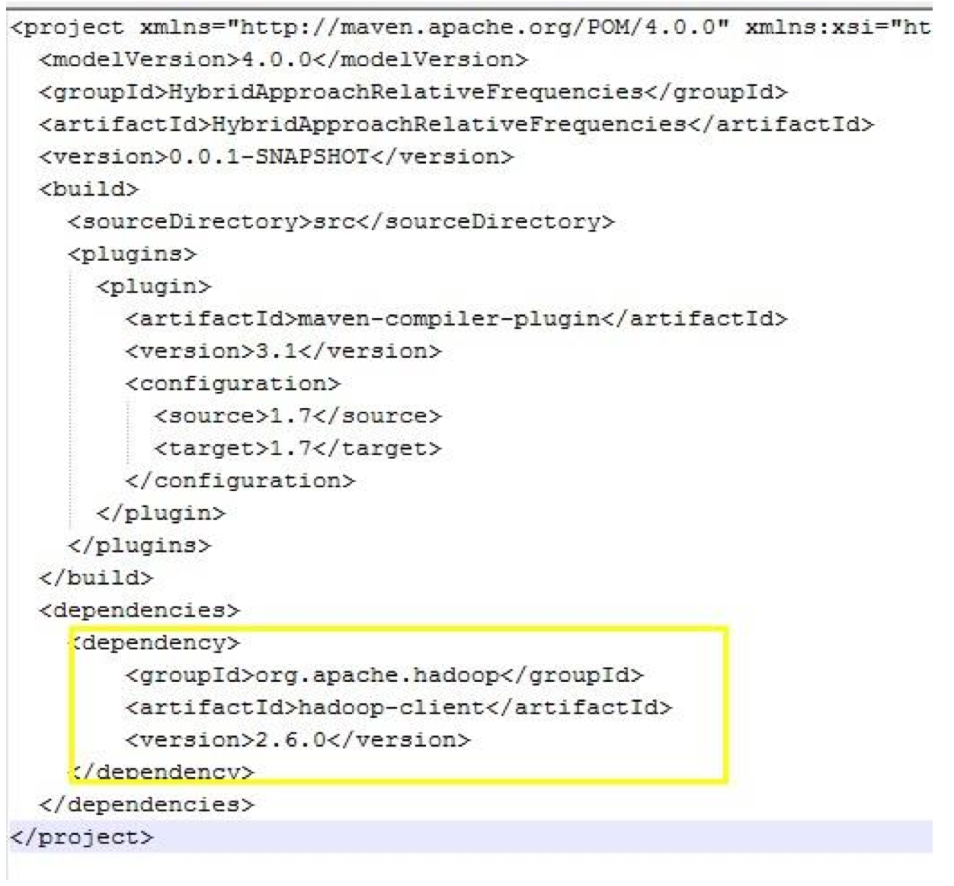
Using Maven Project and POM

Slide 7
Pair Approach - pseudo code
class mapper
method initialize
H = new AssociativeArray<Pair,Integer>
method map(docid id, document doc)
for all term w in doc do
for all term u in N(w) do
H{pair(w,u)}+=1 ;
H{pair(w,*)}+=1;
method close
for all element in H
emit(element.key, element.value)
class partitioner
method getPartition(pair (w, u); value)
if value = 0
return 0;
return hash(w);
class Reducer
total = 0
method reduce(pair p(w, u); counts[c1, c2, c3,...])
s = 0
for all count c in counts [c1; c2; …] do
s = s + c
if( u == “*”)
total = s
else {
f = s/total
Emit(pair p; f)
}

Slide 8
Stripe Approach - pseudo code
class mapper
method initialize
H = new AssociativeArray<Term,AssociativeArray>
method map(docid id, document doc)
for all term w in doc do
temp = new AssociativeArray<Term,Integer>
for all term u in N(w) do
temp{u}+=1
Sum(H{w},temp)
method close
for all element in H do
emit(element.key,element.value)
class reducer
method reduce(Term key,List<AssociativeArray> values)
H = new AssociativeArray<Term,Integer>
count = new Integer;
for all arr in values do
for all e in arr do
count+=e.value;
H{e.key}+=e.value;
for all element in H do
element.value = element.value/count
emit(key,H)

Slide 9
Hybrid Approach - pseudo code
Class Mapper
method Initialize
H = new AssociativeArray()
method Map(docid a; doc d)
for all term w in doc d do
for all term u in neighbor(w) do
H{pair(w; u)} ← H{pair(w; u)} + 1
method Close
for all pair p in H do
Emit(pair p; count H{pair p})

Slide 10
Hybrid Approach - pseudo code
Class Reducer
method inititalize
marginal = 0;
H = new AssociativeArray () //key is term u, value is count c
currentTerm= null;
//this method will be called multiple times
method Reduce(pair(w; u); counts[c1;c2; …])
if (currentTerm == null) then
currentTerm = w;
//when new term w encountered
else if (currentTerm != w) then
for all term u in H do
H{u} = H{u} / marginal

Slide 11
Hybrid Approach - pseudo code
Emit(term currentTerm, stripe H)
//reset for new term
marginal = 0;
H = new AssociativeArray()
currentTerm = w;
for all count c in counts[c1;c2; …] do
H{u} = H{u} + c
marginal = marginal + c
method Close //for the last term w
for all term u in H do
H{u} = H{u} / marginal
Emit(term currentTerm, stripe H)
class partitioner
method getPartition(key,value)
return hash(key.left);

Slide 12
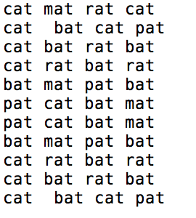
Input

Slide 13
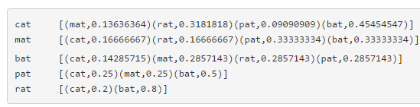
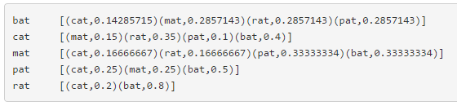
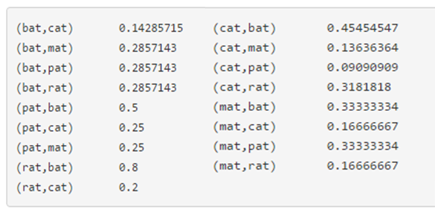
Pair Approach
Output
Stripe Approach
Hybrid Approach

Slide 14
Comparison
 | Pair | Stripe | Hybrid
Map input records | 11 | 11 | 11
Map output records | 22 | 5 | 17
Map output bytes | 254 | 215 | 204
Time spent in maps (ms) | 4557 | 4468 | 4358
Reduce input group | 22 | 5 | 17
Reduce shuttle bytes | 310 | 237 | 244
Reduce input records | 22 | 5 | 17
Reduce output records | 17 | 5 | 5
Time spent in reduces (ms) | 14785 | 13257 | 4694
Total time spent (ms) | 19342 | 17725 | 9052

Slide 15

Spark
a

Slide 16
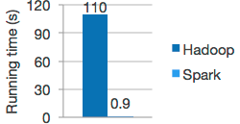
Spark
Spark
Fast and general engine for large-scale data processing
An open source, can be written in Java, Scala, or Python
Run programs up to 100x faster than Hadoop MapReduce in memory, or 10x faster on disk

Slide 17
Spark
WHY Spark?
Real Time Example
Yahoo (a major contributor to Apache Spark) wrote a Spark ML algorithm 120 lines of Scala. (Previously, its ML algorithm for news personalization was written in 15,000 lines of C++.) With just 30 minutes of training on a large, hundred million record data set, the Scala ML algorithm was ready for business.
Spark speeds up data analytics by loading data into memory, providing much faster performance than a disk-based system like Hadoop

Slide 18
Spark
Hardware Requirements Comparison
 | Apache Spark | Apache Hadoop
Cores | 8–16 | 4
Memory | 8 GB to hundreds of gigabytes | 24 GB
Disks | 4–8 | 4–6 one-TB disks
Network | 10 GB or more | 1 GB Ethernet all-to-all

Slide 19
Spark
Problem with Spark
The memory in the Spark cluster should be at least as large as the amount of data you need to process, because the data has to fit into the memory for optimal performance.
Compatability
Apache Spark can run as standalone or on top of Hadoop YARN

Slide 20
Spark
RDD Operations
Two types of operations
1, transformations : create new dataset from existing one . Eg. Map
2, actions : return a value to the driver program after running computation on the dataset
Eg. Reduce
JavaRDD<String> lines = sc.textFile("data.txt");
JavaRDD<Integer> lineLengths = lines.map(s -> s.length())
int totalLength = lineLengths.reduce((a, b) -> a + b);

Slide 21
Spark
Passing Functions to Spark
In Java, functions are represented by classes implementing the interfaces in the org.apache.spark.api.java.function package
Two ways to create such functions :
Implement the Function interfaces in your own class
Lambda expressions in java 8

Slide 22
Spark
…Cont’d
public static Function<Customer, Long> GET_CUSTOMER_ETIME = new Function<Customer, Long>() {
private static final long serialVersionUID = 1L;
@Override
public Long call(Customer customer) throws Exception {
return new Long(customer.getTimeElapsed());
}
};
------------------------------------------------------------------------------------------------------------------------------------
JavaRDD<Long> elapsedTime =
customers.map(Functions.GET_CUSTOMER_ETIME).cache();
System.out.println(String.format("Average Elapsed Time By Customers on the WebPage: %s, Min: %s, Max: %s",
elapsedTime.reduce(Functions.SUM_REDUCER) / elapsedTime.count(),
elapsedTime.min(Functions.LONG_NATURAL_ORDER_COMPARATOR),
elapsedTime.max(Functions.LONG_NATURAL_ORDER_COMPARATOR)));

Slide 23
Spark
Spark Installation
If we do MapReduce in Horton SandBox , there is no need for a separate spark installation. It is already installed in it.
We can test the existence of spark by trying to run some of its commands like :
> spark-shell
> spark-submit
All the procedures we followed for hadoop MapReduce will be the same we just use different spark commands.
Some how if we can’t find it installed, the steps are:-
Download tar file from this link (http://public-repo-1.hortonworks.com/HDP-LABS/Projects/spark/1.2.0/spark-1.2.0.2.2.0.0-82-bin-2.6.0.2.2.0.0-2041.tgz)
Extract it
> tar xvf spark-1.1.0.tgz
3. Set spark hadoop version in env variables ; > SPARK_HADOOP_VERSION=2.6.0

Slide 24
Spark
Eclipse Setup
First we create a java project
Right click on the project > configure > convert to maven
Inside the POM file that will be created we append the following lines of code
<dependencies>
<dependency>
<groupId>org.apache.spark</groupId>
<artifactId>spark-core_2.10</artifactId>
<version>1.3.1</version>
</dependency>
</dependencies>
Finally we create the java files inside the project and we generate a jar file

Slide 25
Spark
Customer Log Analyzer
In this project we tried to analyze logs collected from an online shopping website
We processed the log files using spark and we came out with the following outputs:
- We identified the Gold Customer of the website from the amount of money
they spend using the website.
- Top ten customers by the amount of time they spent visiting the website.
- Average , MIN, and MAX time spent by customer on the website.
and much more analysis can be done on demand.
We have 3 classes namely CustomerAnalyzer, Customer,Functions

Slide 26
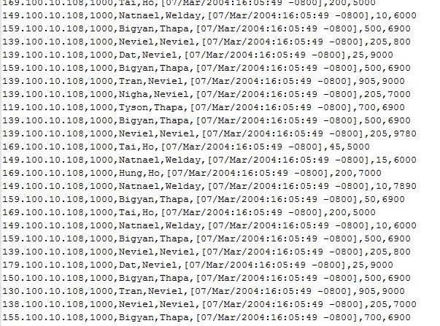
Spark
Sample LOG file
//IP address, customer ID,firs tname, last name, time elapsed, order date, time elapsed, amount

Slide 27
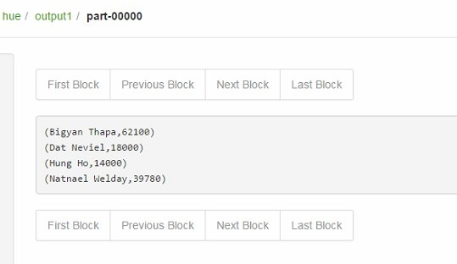
Spark
Sample- Outputs -Screenshots -1
We are writing the outputs to HDFS in to 3 different files for the 3 different outputs
* Top 10 Customers who spent time for our site, sorted by Times elapsed

Slide 28
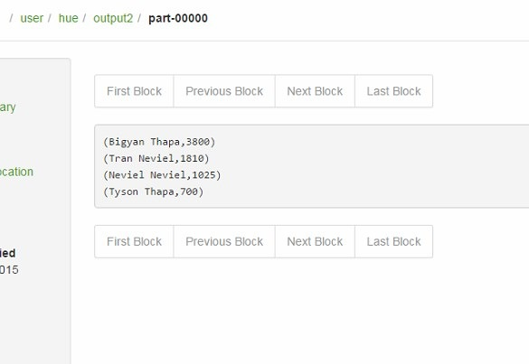
Spark
Sample- Outputs -Screenshots -2
Top 10 Customers by the
Amount of money they
Spend.

Slide 29
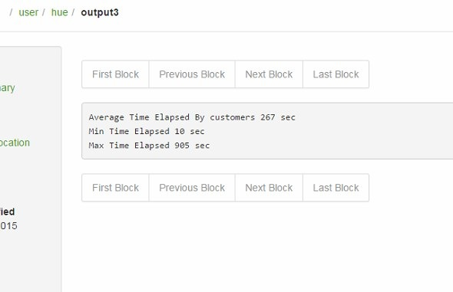
Spark
Sample -Outputs -Screenshots -3
Average, MAX and MIN time
elapsed by customers
in seconds

Slide 30
Questions
You can ask
But…
NO ANSWER :))

Slide 31
Reference
1. https://spark.apache.org/examples.html
2. https://github.com/hortonworks/hadoop-tutorials
3. https://github.com/hortonworks/hadoop-tutorials/blob/master/Community/T09_Write_And_Run_Your_Own_MapReduce_Java_Program_Poll_Result_Analysis.md

Slide 32
That’s it Folks!!!
Thank you
&
Happy Hadooping!!!

